Slide 1

Motivation

Slide 2
Motivation: Concept
Motivation is the process of encouraging the individuals to do the assigned job according to the best of their ability.
According to Stephen P. Robbins “motivation is the willingness to exert high levels of efforts toward organizational goals, conditioned by the effort’s ability to satisfy some individual need”.
Motivation is the process that starts with a physiological or psychological deficiency or needs that activates behaviours or a drive that is aimed at a goal or incentives. (Fred Luthans)
The process by which activities are started, directed, and continued so that physical or psychological needs or wants are met.

Slide 3
Features of motivation
Features of motivation
Psychological process
Continuous process
Concentrated on whole individual
Positive or negative
Complex and unpredictable
Pervasive function
Influences the behaviour

Slide 4
Importance of motivation
Importance of Motivation
Lead to profitable operation
Stability of workforce
Minimizes supervision cost
Achievement of goals
High level of productivity
Best remedy for resistance to change
Effective use of human resources
Satisfaction of employees
Minimizes dispute and strike
Basis of coordination

Slide 5

Techniques of motivation
1. Financial incentives
2. Participation
3. Delegation of authority
4. Job security
5. Job enlargement
6. Job enrichment
7. Job rotation
8. Reinforcement
9. Quality of work life
10. Competition

Slide 6
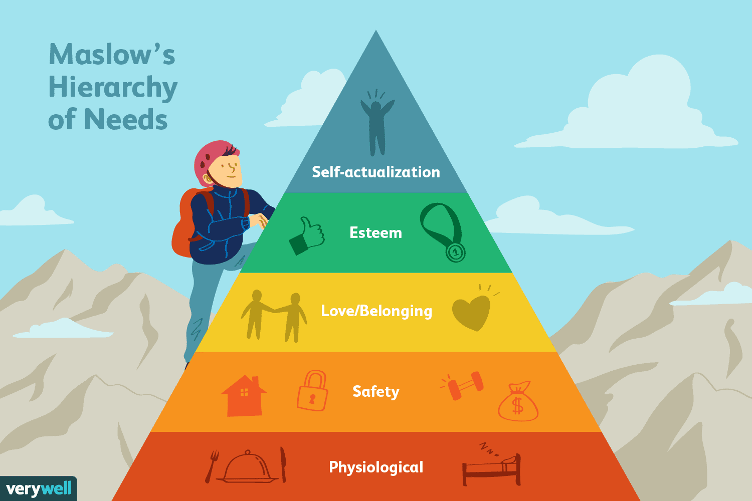
Need hierarchy theory

Slide 7
Maslow’s hierarchy of needs
Developed by Abraham Maslow in 1943
Physiological needs:
Hunger, thrust , sleep are the foundation for other levels of needs.
In physiological term they are the strong motivator to act in a particular job.
These basic needs arise out of physiological or biological tension and are important to sustain life.
Once these needs satisfied, the employees will start to work for higher order needs.
2. Security needs:
In the next level security needs become predominant.
These needs are protection against danger, threat and deprivation.
Retirement, insurance, medical benefits provided by organization for motivating employees.

Slide 8
Maslow’s hierarchy of needs
3. Social/love/belonging needs:
People need to have sense of belonging and acceptance to motivate their behaviour towards certain action.
These needs include the needs for associations with others, belonging to groups, and giving and receiving friendship and affection.
Such needs are satisfied by relationship with friends, families and co-workers.
4. Esteem needs:
Esteem needs include the needs for self respect, respect of others and ego or status.
Self respect is the internal recognition whereas respect of others is external recognition.
Managers can provide self respect by arrangements of good office environment, job title and similar pay arrangements, providing challenging and meaningful jobs to motivate people.

Slide 9
Maslow’s hierarchy of needs
5. Self actualization needs:
It is the desire to become what one is capable of becoming.
The self actualization needs include achieving the potential within oneself , maximum self development, creativity and self-expression.
At this level, and individual seeks challenging work assignments that allow for creativity and opportunities for personal growth and advancement.
The fulfilment of such needs depends on how a managers provides opportunities for his subordinates to participate in decision making, learn new things on the job and in organization.

Slide 10
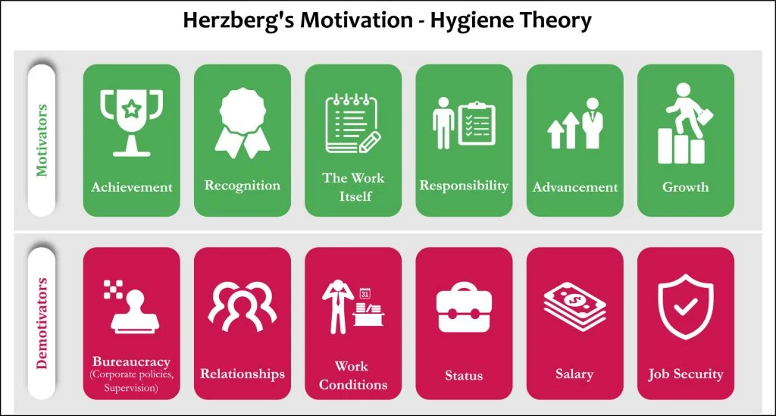
Two Factor Theory

Slide 11
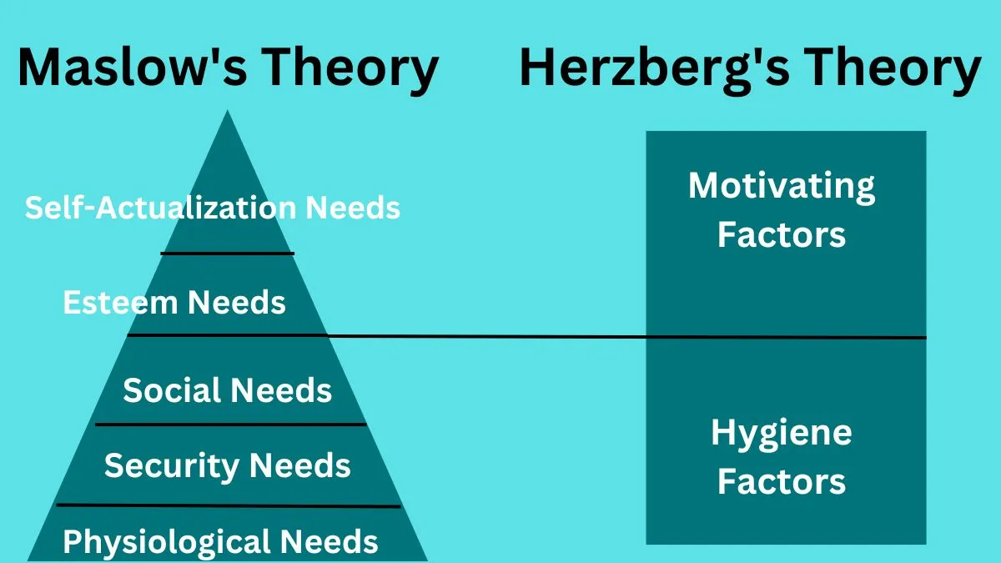
Need hierarchy and two factor theory

Slide 12
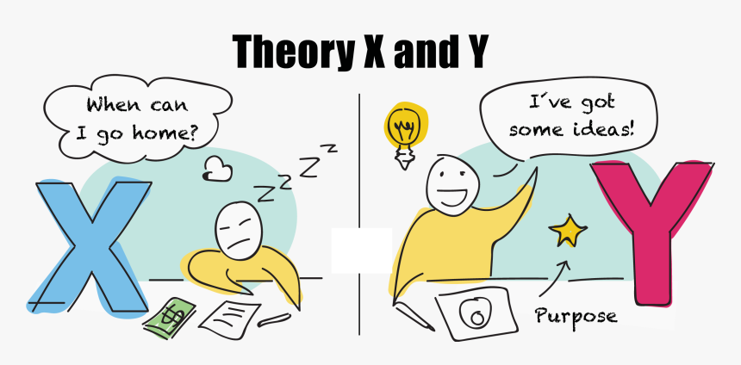
Theory X and Theory Y
Douglas McGregor, a social psychologist, proposed Theory X and Theory Y in his book "The Human Side of Enterprise," published in 1960.
These theories represent contrasting assumptions about human nature and behavior in the workplace.
McGregor argued that a manager's beliefs about the nature of people significantly influence their management style and, consequently, the organizational culture.
He proposed two distinct views of human motivation, one negative labeled theory x and another positive labeled theory Y.

Slide 13
Theory X and Theory Y
Theory X
Assumptions:
People inherently dislike work and will avoid it if possible.
People must be coerced, controlled, directed, or threatened with punishment to get them to achieve organizational objectives.
People prefer to be directed, want to avoid responsibility, have little ambition, and primarily seek security.
The average person is inherently lazy and requires close supervision.
Management Implications:
Authoritarian management style.
Centralized decision-making.
Tight control and close supervision.
Use of external rewards and punishments to motivate employees.

Slide 14
Theory Y
Assumptions:
Work can be as natural as play and rest.
People will exercise self-direction and self-control to achieve organizational objectives to which they are committed.
The commitment to objectives is a function of the rewards associated with their achievement.
People generally view work as a natural part of their lives and seek opportunities to be creative and innovative.
Under the right conditions, people not only accept but also seek responsibility.
The capacity to use a high degree of imagination, ingenuity, and creativity in solving organizational problems is widely distributed in the population.
Management Implications:
Participative management style.
Decentralized decision-making.
Delegation of authority and responsibility.
Encouragement of employee initiative and creativity.
Recognition of the importance of job satisfaction and intrinsic rewards.

Slide 15
Theory X and Theory Y (Concluding Note)
McGregor's intention was not to categorize individuals into either Theory X or Theory Y, but rather to highlight two contrasting sets of assumptions that managers might hold about employees.
He believed that Theory Y assumptions were more likely to lead to a positive and productive work environment.
The challenge, according to McGregor, is for managers to create conditions that allow Theory Y assumptions to flourish and to recognize that individual motivations and attitudes toward work can vary.

Slide 16
McClelland’s Theory of Need (Achievement Motivation Model)
The lower level needs in Maslow’s model are fulfilled by the physiological, societal and working systems of the organization.
However, they are not strong motivator for long time.
The Harvard psychologist David McClelland concluded that the most prominent need is the need for achievement, power and affiliation.
A major factor that provides willingness to perform a given task is the intensity of individual’s need for achievement.

Slide 17

McClelland’s Theory of Need (Achievement Motivation Model)
Need for Affiliation
This needs are more or less similar to Maslow ‘s social needs.
It is the desire to establish and maintain friendly and warm relations with other people.
The people having high need for affiliation will value the feelings of other, have a strong desire for acceptance and approval others, and view the organization as a platform to establish relationships.

Slide 18

McClelland’s Theory of Need (Achievement Motivation Model)
2. Need for power
This is the need to dominate, influence and control people.
They like to set goals, make decisions and directs activities.
People who have a high need for power are characterized by – desire to exercise control over others, concern for establishing leader- follower relations and desire to influence and direct others.

Slide 19

McClelland’s Theory of Need (Achievement Motivation Model)
3. Need for achievements
The main focus of this theory is towards this need.
It is the need for challenges, personal accomplishment and success in competitive situation.
He found that people with high need for achievement perform better than those with a moderate or low need for achievement.
Take personal responsibility, take risk and set challenging goals, take feed back on their performance.

Slide 20
Contemporary Perspectives
Equity Theory
Reinforcement Theory
Goal Setting Theory
Expectancy Theory

Slide 21
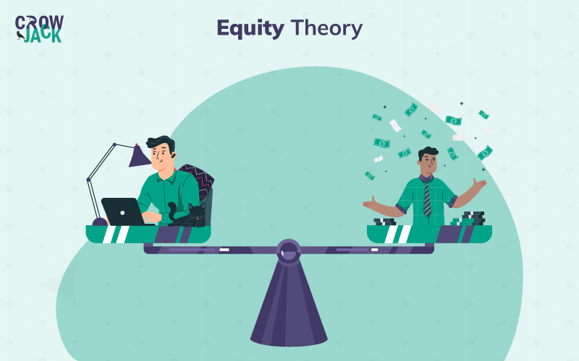
Equity Theory

Slide 22
Equity theory
Equity theory is a psychological concept developed by J. Stacy Adams in the early 1960s, which focuses on the perceived fairness of social exchanges within relationships.
The theory suggests that individuals strive for fairness and equity in their relationships and compare their inputs and outcomes to those of others.
Adams proposed that people are motivated to maintain a balance between their inputs (efforts, contributions) and outcomes (rewards, benefits) in relation to the inputs and outcomes of others.
Key principles of equity theory include:
Inputs and Outcomes: Inputs refer to the contributions or efforts people put into a relationship or a job, while outcomes represent the rewards or benefits they receive. Examples of inputs include time, effort, skills and outcomes can include recognition, salary, and promotions.
Equity Comparison: Individuals compare their own input-to-outcome ratios with the input-to-outcome ratios of others. If the ratios are perceived as equitable, individuals are likely to be satisfied. However, inequity may lead to discomfort and motivation to restore balance.

Slide 23
Equity theory
Equity Distress: When individuals perceive an inequity (either over-rewarded or under-rewarded compared to others), they may experience distress. This distress can lead to various behavioral and cognitive reactions aimed at restoring a sense of equity.
Restoration of Equity: People can restore equity by adjusting their inputs, changing their outcomes, altering their perceptions of the situation, or leaving the relationship or situation altogether.
Perceived Fairness: Equity theory is based on the subjective perception of fairness. It's not just about the objective distribution of rewards but also about how individuals perceive that distribution.

Slide 24
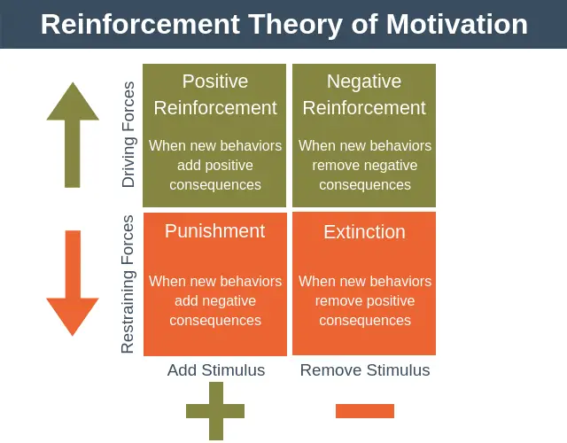
Reinforcement Theory- B.F. Skinner

Slide 25
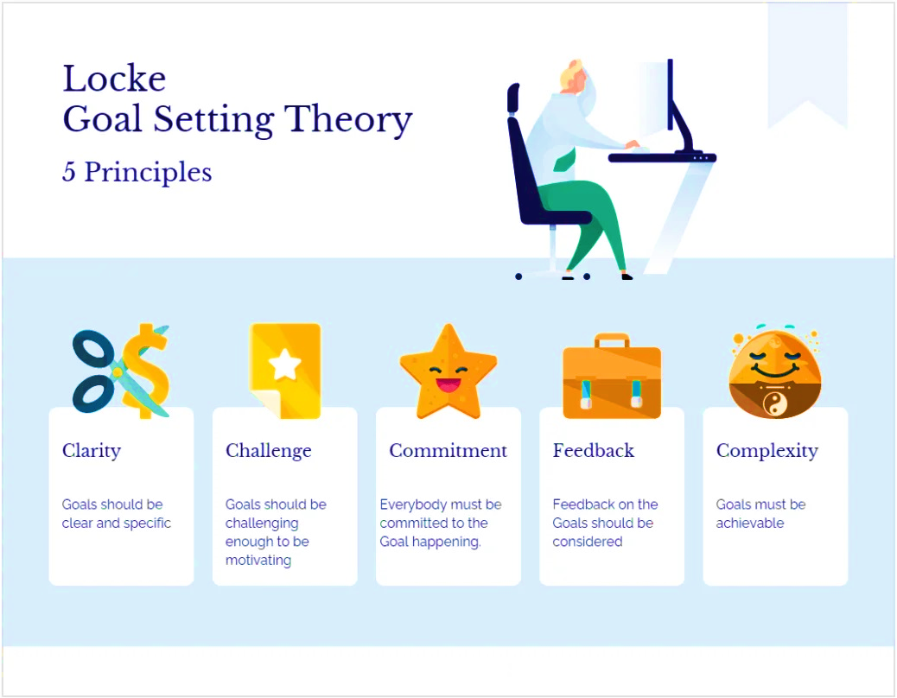
Goal Setting theory- Edwin Locke

Slide 26
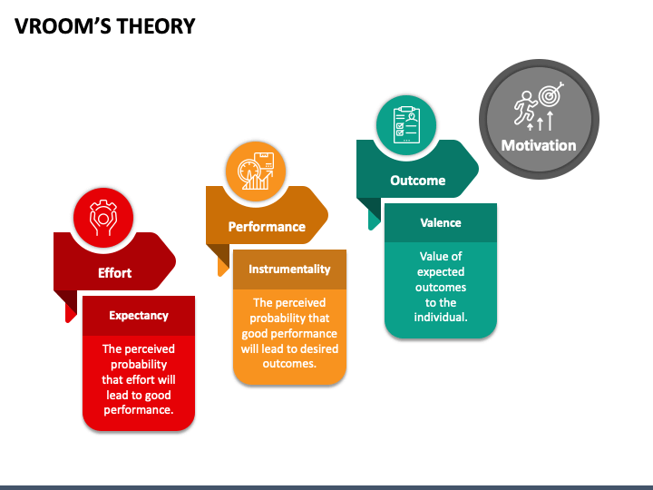
Expectancy Theory- Victor Vroom

Slide 27
Expectancy theory
Vroom's Expectancy Theory, developed by Victor Vroom in the 1960s, is a motivational theory that focuses on the relationship between an individual's efforts, performance, and the attainment of desired outcomes.
This theory suggests that people are motivated to act in a certain way based on their expectations of the outcomes of their behavior.
The theory is based on three key components:
Expectancy (E): This refers to the belief that an individual has regarding the likelihood that their efforts will lead to successful performance. In other words, it's the perception that if they put in the effort, they can achieve the desired level of performance.
Instrumentality (I): Instrumentality is the belief that successful performance will lead to certain outcomes or rewards. It assesses the perceived connection between performance and the expected outcome. If an individual believes that good performance will result in a reward, they are more likely to be motivated.
Valence (V): Valence represents the value or attractiveness that an individual places on the anticipated outcome or reward. Different individuals may have different preferences for rewards, and valence reflects the subjective value attached to the potential outcomes.

Slide 28
Expectancy theory
The Expectancy Theory formula is often expressed as:
Motivation = (Expectancy)×(Instrumentality)×(Valence)
According to Vroom, an individual will be motivated to exert effort if they believe that
their efforts will lead to successful performance (high expectancy),
that successful performance will result in desirable outcomes (high instrumentality),
and that the outcomes are personally valuable or attractive (high valence).

Slide 29
Contemporary Issues in Motivation
Contemporary issues in motivation encompass a variety of challenges and debates that arise in understanding, fostering, and sustaining motivation in individuals and groups within today's rapidly changing societal and organizational contexts. Some of these issues include:
Remote Work Challenges: With the increasing prevalence of remote work arrangements, maintaining motivation among employees who are physically distant from their colleagues and supervisors becomes a significant issue. Remote work can lead to feelings of isolation, reduced accountability, and difficulties in maintaining work-life balance, all of which can impact motivation levels.
Generational Differences: Different generations in the workforce, such as Baby Boomers, Generation X, Millennials, and Generation Z, may have varying preferences and motivators. Understanding and accommodating these differences in motivational factors, communication styles, and work preferences can be challenging for organizations.

Slide 30
3. Work-Life Balance: Achieving a healthy balance between work and personal life is increasingly important for employee motivation and well-being. Employers need to consider flexible work arrangements, leave policies, and support systems to help employees manage competing demands and maintain motivation.
4. Intrinsic vs. Extrinsic Motivation: There's an ongoing debate about the relative importance of intrinsic (internal) versus extrinsic (external) motivators in driving behavior and performance. While intrinsic motivation, such as a sense of purpose or autonomy, is often considered more sustainable and effective, organizations may rely heavily on extrinsic rewards like bonuses and financial incentives.
5. Employee Engagement: Engaging employees in their work and fostering a sense of connection to the organization's mission and values is crucial for motivation. However, many organizations struggle to create environments where employees feel valued, heard, and empowered to contribute meaningfully.

Slide 31
6. Diversity and Inclusion: Ensuring that all employees feel included and valued regardless of their background or identity is essential for maintaining motivation and fostering a positive work culture. Organizations need to address issues of bias, discrimination, and other barriers that may hinder certain groups' motivation and engagement.
7. Health and Well-being: Employee well-being, both physical and mental, is closely linked to motivation and productivity. Organizations need to prioritize initiatives that promote employee health, such as wellness programs, mental health support, and ergonomic work environments.
8. Purpose-driven Work: Increasingly, employees seek meaning and purpose in their work beyond financial compensation. Organizations that align their mission with social or environmental causes may attract and retain motivated employees who are passionate about making a positive impact.

Slide 32
Suggestions for motivating employees
Recognize individual differences
Recognition and Appreciation
Opportunities for Growth and Development
Feedback and Communication
Autonomy and Empowerment
Work-Life Balance
Incentives and Rewards
Team Building and Collaboration
Clear Goals and Expectations
Wellness Initiatives
Lead by Example
Stay Flexible and Adaptive

